Slide 1
Trees
DSA

Slide 2
Recap
Primitives are basic building blocks which have known size and known persistence .The collection of these primitive types allow optimized execution balanced with storage size.
Above these Primitives are Lists, stacks, and queues – the fundamental data structures in all of computer science
When do we use Q?
Write Is_Empty() for a queue
Analytical Solutions Vs Simulations
Notes:
Q – FCFS; Printer jobs, customer center calls; Ele can be removed from the middle also;
Stacks – it may appear that they are inflexible since they can be removed / added only from one end & No random access allowed. However, imagine if there is a house with multiple entry / exits. It offers flexibility but difficult to administer and cannot be tracked…. There are instances where it can be extremely light weight and easy to use. So that’s the advantage.

Slide 3
Intro
So far we have seen linear access – order (N)
Now lets gets to see O(Log n)

Slide 4
“The difference between a bad programmer and a good one is whether he considers his code or his data structures more important. Bad programmers worry about the code. Good programmers worry about data structures and their relationships”
designing your code around the data, rather than the other way around has always been better

Slide 5
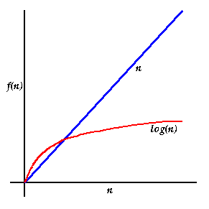
N Vs Log n

Slide 6
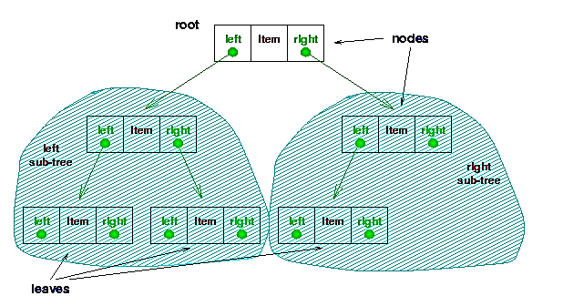
Terminology

Slide 7
Components of a Tree
Node: stores a data element
Parent: single node that directly precedes a node
all nodes have 1 parent except root (has 0)
Child: one or more nodes that directly follow a node
Ancestor: any node which precedes a node itself, its parent, or an ancestor of its parent
Descendent: any node which follows a node itself, its child, or a descendent of its child

Slide 8
Leaf (external) node: node with no children
Internal node: non-leaf node
Siblings: nodes which share same parent
Subtree: a node and all its descendents
Ignoring the node’s parent, this is itself a tree
Ordered tree: tree with defined order of children
enables ordered traversal
Binary tree: ordered tree with up to two children per node

Slide 9
Trees - Examples
Directory tree
Organizes directories and files hierarchically
Directories are internal nodes, files are leaf nodes (usually)
Class hierarchy
Object is root, other classes are descendants
Decision tree
Binary tree
Path taken determined by Boolean expression
Expression tree
Operators are internal nodes, variables and constants are leaf nodes

Slide 10
Operations
root( ): returns root
parent(v): returns parent of v
children(v): returns iterator of children of v
size( ): returns number of nodes
elements( ): returns iterator of all elements
positions( ): returns iterator of all positions/nodes
swapElements(v,w): swaps elements at two nodes
replaceElement(v,e): replaces element of a node
Queries
isInternal(v): test if node is internal
isExternal(v): test if node is external
isRoot(v): test if node is root

Slide 11
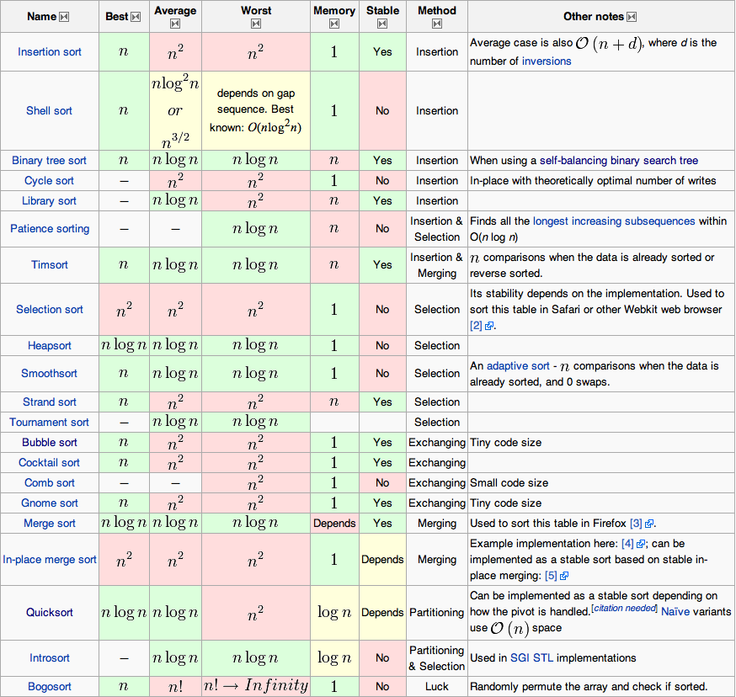
Notes:
http://www.victusspiritus.com/2011/03/17/brushing-up-on-computer-science-part-4-algorithms/

Slide 12
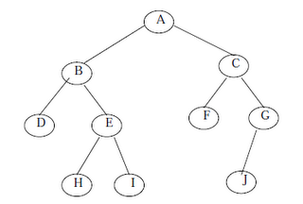
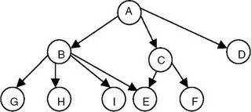
Tree or not?

Slide 13
Terminologies
Node: Each data item in a tree is called a node.
Node specifies the data information and links to other data items
Root: Root is the first node in the tree
Node A is the root node in the tree example
Degree of a Node: Degree of a node is the number of subtrees of a node in a given tree.
Degree of a Tree: The Degree of a tree is the maximum degree of node in a given tree.

Slide 14
Leaf Node (or) Terminal Node: A node with degree 0 is called a leafnode
ie a node with no subtrees or children is called leafnode.
Any node whose degree is non-zero is called non-terminal node
Level of a Node: The tree is structured in different levels.
The root node is always at level 0.Then its immediate children are at level 1and their immediate children are at level 2 and so on up to the terminal nodes
i.e. If a node is at level n, then its children will be at level n+1.
Depth of a tree (or)Height of a tree: Depth of a tree is the maximum level of any node in a given tree.
including level 0

Slide 15
Tree Traversals
Unlike linear data structures (Array, Linked List, Queues, Stacks, etc) which have only one logical way to traverse them, trees can be traversed in different ways.
General ways for traversing trees
Depth-First traversal
Breadth First traversal

Slide 16
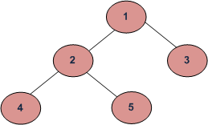
Depth-First
Inorder
Postorder
Preorder

Slide 17
Breadth First
Only one type of traversal
Level Order traversal

Slide 18
Pre-Order
Visit the root.
Traverse the left sub-tree, i.e., call Preorder (left-subtree)
Traverse the right subtree, i.e., call Preorder(right-subtree)
Preorder traversal for the given figure is 1 2 4 5 3
Preorder traversal is used to create a copy of the tree.

Slide 19
Post-Order
Traverse the left subtree, i.e., call Postorder (left-subtree)
Traverse the right subtree, i.e., call Postorder(right-subtree)
Visit the root.
Postorder traversal for the figure is 4 5 2 3 1.
Postorder traversal is used to delete the tree

Slide 20
Post Order
Step-1: For current node check if it has a left child. If it has then go to step-2 or else step-3 Step-2: Repeat step-1 for this left child Step-3: Visit the current node (for printing, etc) Step-4: For the current node check whether it has a right child. If it has then go to step-5 Step-5: Repeat step-1 for this right child

Slide 21

Binary Tree
Any Tree whose nodes can have at the most two children is called a Binary tree or a tree with order 2.
this has got some significance
Every node in a Binary tree has a structure like this -
Struct NODE { struct NODE *leftchild; Int nodevalue; /*this can be of any type*/ struct NODE *rightchild; }
Similar to doubly Linked List

Slide 22
Binary Tree
for the new element to be added, compare it with the current element in the tree.
If its value is less than the current element in the tree then move towards the left side of that element
else to its right.
If there is no sub tree on the left, make your new element as the left child of that current element or else compare it with the existing left child and follow the same rule.
Exactly same has to done for the case when your new element is greater than the current element in the tree but this time with the right child.

Slide 23
BT - Algo
Step-1: If Value of New element < current element then go to step-2 or else step-3
Step-2: If the Current element does not have a left sub-tree then make your new element the left child of the current element; else make the existing left child as your current element and go to step-1
Step-3: If the current element does not have a right sub-tree then make your new element the right child of the current element; else make the existing right child as your current element and go to step-1

Slide 24
BT – create tree
struct NODE { struct NODE *left; int value; struct NODE *right; }
create_tree( struct NODE *curr, struct NODE *new ) { if(new->value <= curr->value) { if(curr->left != NULL) create_tree(curr->left, new); else curr->left = new; } else { if(curr->right != NULL) create_tree(curr->right, new); else curr->right = new; } }

Slide 25
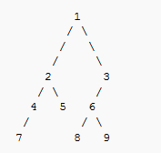
Tree Traversal
preorder:
1 2 4 7 5 3 6 8 9
inorder:
7 4 2 5 1 8 6 9 3
postorder:
7 4 5 2 8 9 6 3 1
level-order:
1 2 3 4 5 6 7 8 9

Slide 26
Use of Binary Trees – Expression Trees
Leaves of the ET are operands
Other nodes contains operators
Convert a Postfix to Expression Tree

Slide 27
ET – Construction steps
Preparation
Stack structure
Tree Structure
Read one expression at a time
If it is an Operand
Create 1-node tree
Push the pointer to Stack
If Operator
POP 2 trees
Create a Tree with Operator as Root and Right/Left pointers to the 2 trees popped
Example a b + c d e + * *

Slide 28
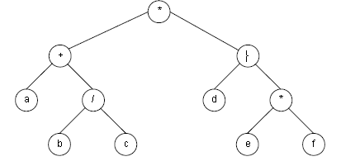
Expression Tree – an example
(a + b/c) * (d – e*f)

Slide 29
Use of BT – Binary Search tree
Consider a Binary Tree
Assume item is an integer that is unique in the tree
Since it is unique, the item is referred to as a “key”
Consider any node X with a key value K
At every node if all keys in the Left sub-tree are less than K and all keys in Right sub-tree are > K, it is considered as BST

Slide 30
BST
10
5
12
3
6
11
10
5
12
7
3
6
7

Slide 31
BST operations and examples
MakeEmpty / Initialize
Find a key K
Insert
Delete
Programming a sample BST is left to the student as an exercise as part of the Lab. A sample code for BT is shown in the class
treeBT.c

Slide 32
Other BST operations
FindMin
FindMax

Slide 33
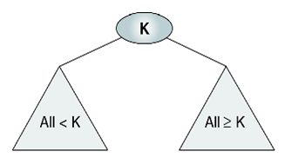
Some Recap… BST
All items in the left subtree are less than the root.
All items in the right subtree are greater or equal to the root.
Each subtree is itself a binary search tree.
Binary search trees provide an excellent structure for searching a list and at the same time for inserting and deleting data into the list.

Slide 34
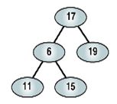
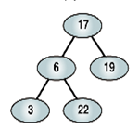

Valid BST?
invalid
invalid
valid

Slide 35
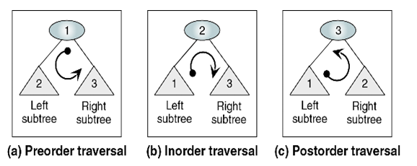
Recap – Traversal in BST
PreOrder: visit root before the subtrees)
InOrder: traversal of a BST produces a sorted list in ascending order
PostOrder: visit root after the subtrees

Slide 36
Example
Consider a Tree like this
10
8
7
5
4
3

Slide 37
Example
Consider another Tree like this
10
8
11
7
12
5
15
4
17
3
20

Slide 38
BST drawbacks
The disadvantage of BSTs is that in the worst-case their asymptotic running time is reduced to linear time.
happens if the items inserted into the BST are inserted in order or in near-order.
In such a case, a BST performs no better than an array.

Slide 39
Concept of Balance
Balanced
A tree is perfectly balanced, if for each node the numbers of nodes in its left and right sub-trees differ by at most 1.
Trees satisfying this condition are often called AVL-trees

Slide 40
AVL Trees
Adelson-Velskii-Landis
Binary Search Tree with a balanced condition
Ensures that depth of tree is O(LOG(n))

Slide 41
AVL
An AVL tree is another balanced binary search tree.
Named after their inventors, Adelson-Velskii and Landis, they were the first dynamically balanced trees to be proposed.
they may not be perfectly balanced, but pairs of sub-trees differ in height by at most 1, maintaining an O(logn) search time.
Addition and deletion operations also take O(logn) time.
An AVL tree is a binary search tree which has the following properties:
The sub-trees of every node differ in height by at most one.
Every sub-tree is an AVL tree.
Trees which remain balanced - and thus guarantee O(logn) search times - in a dynamic environment. Or more importantly, since any tree can be re-balanced - but at considerable cost - can be re-balanced in O(logn) time.

Slide 42
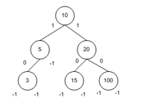
AVL
Valid AVL Tree since for each node in the tree
The height of Left and Right sub-nodes differs by <= 1
Assumes Null Child (Leaf) height is -1 (minus 1)

Slide 43
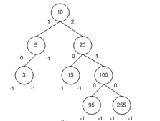
AVL
Valid AVL Tree since for each node in the tree
The height of Left and Right sub-nodes differs by <= 1
Null Child (Leaf) height is -1 (minus 1)

Slide 44
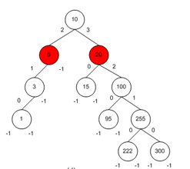
AVL
NOT Valid AVL Tree since for each node in the tree
The height of Left and Right sub-nodes differs by > 1

Slide 45
AVL
AVL trees are binary search trees, so in addition to maintaining a balance property, an AVL tree must also maintain the binary search tree property.
When creating an AVL tree data structure, the challenge is to ensure that the AVL balance remains regardless of the operations performed on the tree.
That is, as nodes are added or deleted, it is vital that the balance property remains.
How do they maintain the balance?
through rotations.
A rotation slightly reshapes the tree's topology such that the AVL balance property is restored and, just as importantly, the binary search tree property is maintained.

Slide 46
Other operations - BST
Smallest Right of a node
Largest Left of a node

Slide 47
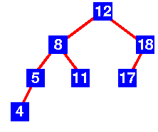
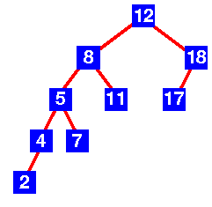
Quiz - AVL or not?
AVL Tree. Each left sub-tree has a height 1 greater than each right sub-tree.
Not AVL Tree. Sub-tree with root 8 has height 4 and sub-tree with root 18 has height 2

Slide 48
The Balance Factor
In order to detect when a “violation” of a AVL tree occurs, we need to have each node keep track of the difference in height between its right and left sub-trees.
Notation for the balance factor:
bf (node) = LeftHeight – RightHeight
To be a valid AVL Tree, -1 <= bf(x) <= 1 for all nodes.

Slide 49
AVL Trees
AVL trees are height-balanced binary search trees
Balance factor of a node
height(left subtree) - height(right subtree)
An AVL tree has balance factor calculated at every node
For every node, heights of left and right subtree can differ by no more than 1
Store current heights in each node
struct AvlNode
{
ElementType Element;
AvlTree Left;
AvlTree Right;
int Height;
};

Slide 50
Node Heights
Tree A (AVL)
Tree B (AVL)
height=2 BF=1-0=1
2
6
6
1
0
1
1
4
9
4
9
0
0
0
0
0
1
5
1
5
8
height of node = h
balance factor = h_{left}-h_{right}
empty height = -1

Slide 51
Node Heights after Insert 7
Tree A (AVL)
Tree B (not AVL)
2
3
balance factor
1-(-1) = 2
6
6
1
1
1
2
4
9
4
9
0
0
0
0
0
1
-1
1
5
7
1
5
8
0
7
height of node = h
balance factor = h_{left}-h_{right}
empty height = -1

Slide 52
Insert and Rotation in AVL Trees
Insert operation may cause balance factor to become 2 or –2 for some node
only nodes on the path from insertion point to root node have possibly changed in height
So after the Insert, go back up to the root node by node, updating heights
If a new balance factor (the difference h_{left}-h_{right}) is 2 or –2, adjust tree by rotation around the node

Slide 53
Insertion imbalance - AVL
After an insertion, when the balance factor of node A is –2 or 2, the node A is one of the following four imbalance types
LL: new node is in the left subtree of the left child of A
LR: new node is in the right subtree of the left child of A
RL: new node is in the left subtree of the right child of A
RR: new node is in the right subtree of the right child of A
Outside cases
Inside cases

Slide 54
Left Rotation
In a binary search tree, pushing a node A down and to the left to balance the tree.
A's right child replaces A, and the right child's left child becomes A's right child.
A
9
15
Left Rotation
4
15
22
9
12
22
12
4

Slide 55
Right Rotation
In a binary search tree, pushing a node A down and to the right to balance the tree.
A's left child replaces A, and the left child's right child becomes A's left child.
A
15
9
Right Rotation
22
9
4
15
12
4
12
22

Slide 56
AVL Insertion: Outside Case
j
Consider a valid
AVL subtree
k
h
Z
h
h
X
Y

Slide 57
AVL Insertion: Outside Case
j
Inserting into X
destroys the AVL
property at node j
k
h
Z
h+1
h
Y
X

Slide 58
AVL Insertion: Outside Case
j
Do a “right rotation”
k
h
Z
h+1
h
Y
X

Slide 59
Single right rotation
j
Do a “right rotation”
k
h
Z
h+1
h
Y
X

Slide 60
Outside Case Completed
k
“Right rotation” done!
(“Left rotation” is mirror
symmetric)
j
h+1
h
h
X
Y
Z
AVL property has been restored!

Slide 61
AVL Insertion: Inside Case
j
Consider a valid
AVL subtree
k
h
Z
h
h
X
Y

Slide 62
AVL Insertion: Inside Case
Inserting into Y
destroys the
AVL property
at node j
j
Does “right rotation”
restore balance?
k
h
Z
h
h+1
X
Y

Slide 63
AVL Insertion: Inside Case
k
“Right rotation”
does not restore
balance… now k is
out of balance
j
h
X
h
h+1
Z
Y

Slide 64
AVL Insertion: Inside Case
Consider the structure
of subtree Y…
j
k
h
Z
h
h+1
X
Y

Slide 65
AVL Insertion: Inside Case
j
Y = node i and
subtrees V and W
k
h
Z
i
h
h+1
X
h or h-1
V
W

Slide 66
Double rotation : first rotation
j
left rotation complete
i
Z
k
W
V
X

Slide 67
Double rotation : second rotation
j
Now do a right rotation
i
Z
k
W
V
X

Slide 68
Double rotation : second rotation
right rotation complete
Balance has been
restored
i
k
j
h
h
h or h-1
V
X
W
Z

Slide 69
AVL Trees
Single Rotation
Double rotation
Node declaration for AVL

Slide 70
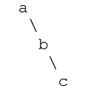

Rotation
left rotation, rooted at A
Steps:
b becomes the new root.
a takes ownership of b's left child as its right child, or in this case, null.
b takes ownership of a as its left child.

Slide 71

c
b
a
Single right rotation rooted at c
Steps:
b becomes the new root.
c takes ownership of b's right child, as its left child. In this case, that value is null.
b takes ownership of c, as it's right child.

Slide 72
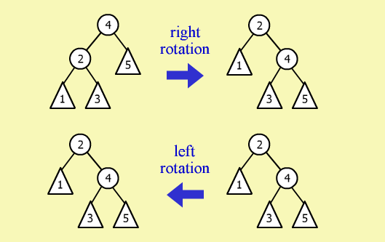

Slide 73
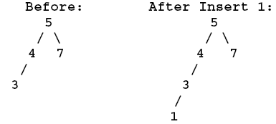
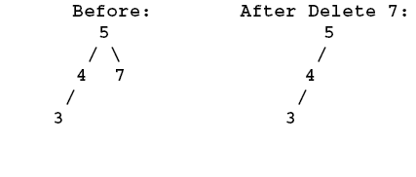
Violations
Notation: NODE = Left-Ht, Right-Ht
No!
Node 5 = 3,1
Node 4 = 2,0
No!
Node 5 = 2, 0

Slide 74
Scenarios
AVL

Slide 75
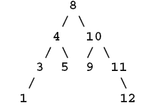
The Balance Factor
Notation for the balance factor:
bf (node) = Left-Ht – Right- Ht
bf(8) = 3 – 3 = 0
bf(4) = 2 – 1 = 1
bf(10) = 1 – 2 = -1
bf(3) = 1 – 0 = 1
bf(5) = 0 – 0 = 0
bf(9) = 0 – 0 = 0
bf(11) = 0 – 1 = -1
bf(1) = 0 – 0 = 0
bf(12) = 0 – 0 = 0
Valid Tree!!

Slide 76

The Balance Factor (Cont’d)
Notation for the balance factor:
bf (node) = Left-Ht – Right- Ht
bf(8) = 2 – 0 = 2
bf(4) = 1 – 0 = 1
Bf(3) = 0 – 0 = 0
Invalid Tree!!

Slide 77
What is a rotation?
A rotation is an operation to rearrange nodes to maintain balance of an AVL tree after adding and removing a node
There are two cases to perform the rotation
1) Single Rotation
2) Double Rotation
When to perform rotations?
we need to perform a rotation anytime a node’s balance factor is 2 or -2

Slide 78
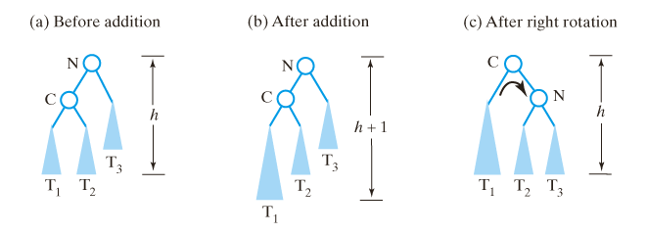
Single Rotations (Cont’d)
Algorithm for right rotation
Algorithm rotateRight(nodeN) nodeC = left child of nodeN Set nodeN’s left child to nodeC’s right child Set nodeC’s right child to nodeN

Slide 79
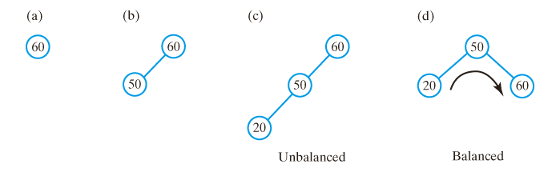
Single Rotations
After inserting (a) 60; (b) 50; (c) 20 into an initially empty binary search tree, the tree is not balanced; d) a corresponding AVL tree rotates its nodes to restore balance.

Slide 80
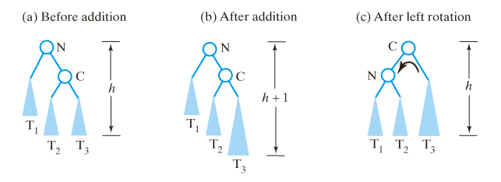
Single Rotations (Cont’d)
Algorithm for left rotation
Algorithm rotateLeft(nodeN) nodeC = right child of nodeN Set nodeN’s right child to nodeC’s left child Set nodeC’s left child to nodeN

Slide 81

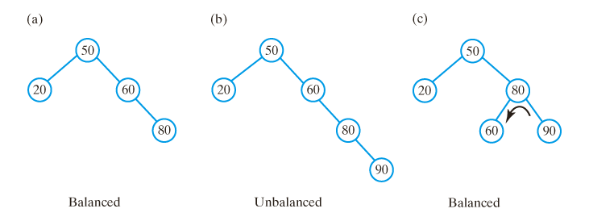
Single Rotations (Cont’d)
Adding 80 to tree does not change the balance of the tree;
a subsequent addition of 90 makes tree unbalanced;
left rotation restores balance.

Slide 82
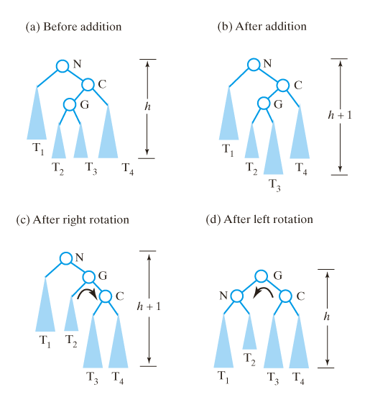
Double Rotations
Before and after an addition to an AVL sub-tree that requires both a right rotation and a left rotation to maintain its balance.

Slide 83
Recall - Insertion imbalance - AVL
After an insertion, when the balance factor of node A is –2 or 2, the node A is one of the following four imbalance types
LL: new node is in the left subtree of the left child of A
LR: new node is in the right subtree of the left child of A
RL: new node is in the left subtree of the right child of A
RR: new node is in the right subtree of the right child of A

Slide 84
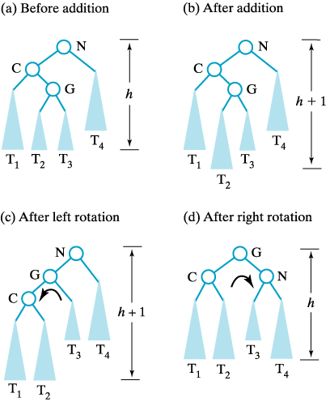
Double Rotations (Cont’d)
Before and after an addition to an AVL sub-tree that requires both a left and right rotation to maintain its balance.

Slide 85
Double Rotations (Cont’d)
Algorithm rotateLeftRight(nodeN)
nodeC = left child of nodeN Set nodeN’s left child to the sub-tree produced by
rotateLeft(nodeC) rotateRight(nodeN)

Slide 86
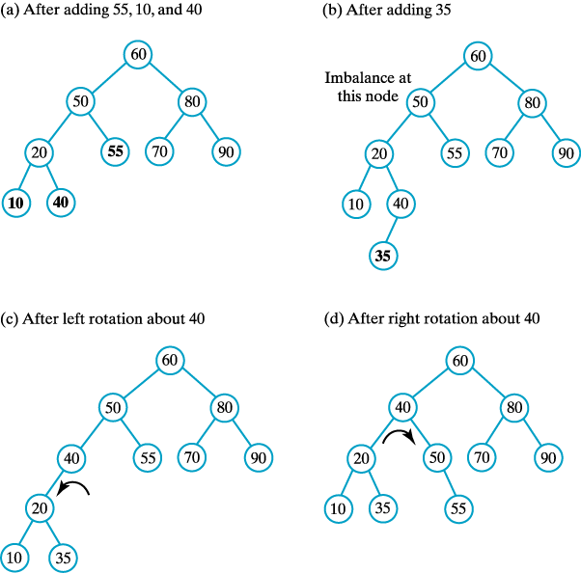

Double Rotations (Cont’d)
Inserting 10 ,40,and 55 maintain its balance
Inserting 35 destroys the balance
After a left rotation
After a right rotation

Slide 87
Double Rotations (Cont’d)
Algorithm rotateRightLeft(nodeN)
nodeC = right child of nodeN Set nodeN’s right child to the sub-tree produced by
rotateRight(nodeC) rotateLeft(nodeN)

Slide 88
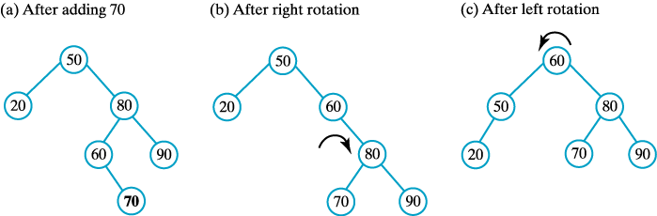
Double Rotations (Cont’d)
(a) Adding 70 to the tree destroy its balance. To restore the balance, perform both
(b) a right rotation and
(c) a left rotation.

Slide 89
Revisit Deletion of BST node
Deletion logic in BST a bit tricky
Concept of soft-delete or lazy deletion
Lazy deletion is marking a flag as “deleted”
Used when deletion are rare
possible cases when a node is being deleted
The node to be deleted has no children. In this case, all we need to do is delete the node.
The node to be deleted has only a right subtree. We delete the node and attach the right subtree to the deleted node’s parent.
The node to be deleted has only a left subtree. We delete the node and attach the left subtree to the deleted node’s parent.
The node to be deleted has two subtrees. It is possible to delete a node from the middle of a tree, but the result tends to create very unbalanced trees.

Slide 90
We can find the largest node in the deleted node’s left subtree and move its data to replace the deleted node’s data.
We can find the smallest node on the deleted node’s right subtree and move its data to replace the deleted node’s data.
Either of these moves preserves the integrity of the binary search tree.

Slide 91
